Slide 1

EDA PROJECT ON Analysis OF TOP 500 COMPANIES(INDIA)
PRESENTED BY:-
J.Varshini Priya
R.Harika

Slide 2
AGENDA
Objectives
Tools Used (Python, Pandas, Matplotlib, Seaborn)
Dataset Overview
Exploratory Data Analysis
Data Cleaning & Preprocessing
Data Visualizations
Observations & Insights
Conclusion

Slide 3


Problem Statement
There is limited clarity on how India’s top companies differ in employee satisfaction, salaries, benefits, and hiring patterns across industries and locations.
Without proper analysis, it becomes difficult to identify trends, compare sectors, and derive insights that help job seekers, employers, and analysts to make informed decisions.
OBJECTIVES
To perform detailed exploratory data analysis (EDA) on the top 500 companies.
To identify patterns and trends among key variables.
To find the most influential features that affect the overall company performance and employee experience.
To visualize relationships and correlations using Python libraries.

Slide 4


Tools Used for EDA
Python (3.12)+ Jupiter Notebook
Python libraries : Pandas ,NumPy, Matplotlib, Seaborn.
For data analysis : Pandas , NumPy.
For data visualization : Matplotlib, Seaborn.

Slide 5


DATASET OVERVIEW
DATASET SHAPE
df.shape = 500rows × 8 columns
KEY COLUMNS:-
df.columns()=
  Company name
  Ratings
  Services
  Location
  Salaries
  Interviews
  Jobs
  Benefits
Dataset Type: Structured tabular data containing company-level information on ratings, salaries, benefits, jobs, interviews, services, and locations, details.
5

Slide 6
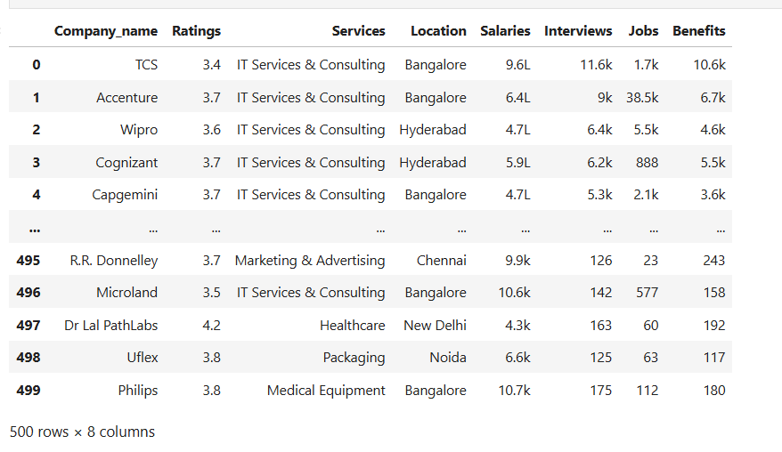
DATA FRAME

Slide 7
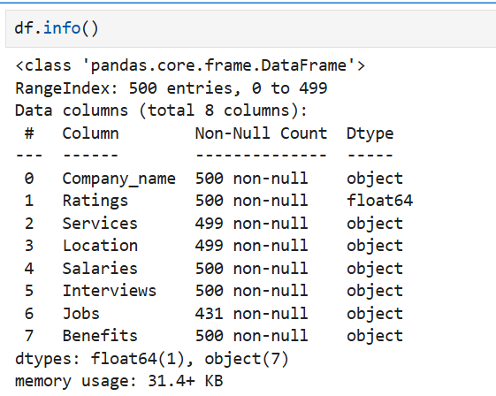
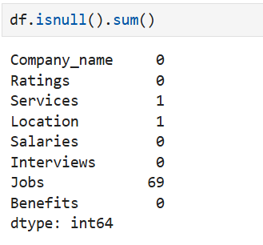

Slide 8

Data Cleaning & Preprocessing
The dataset was checked for missing values and duplicates. We identified null values and replaced them with suitable substitutes, ensuring data completeness.
Duplicate records were not present, ensuring data accuracy and integrity.
Outliers were detected using box plots and statistical methods for numeric features () to understand data distribution and identify extreme values.
Data types were verified and corrected where necessary for proper analysis.

Slide 9
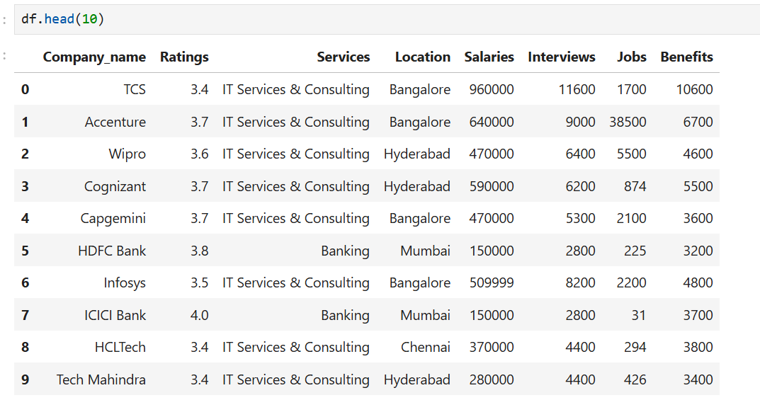
CLEANED DATA FRAME

Slide 10
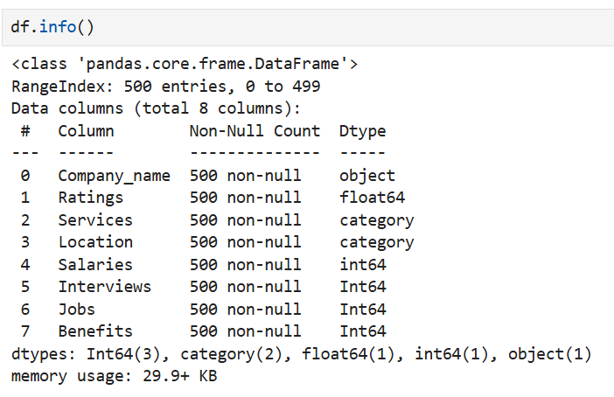
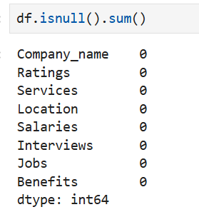

Slide 11
DATA VISUALIZATIONS
Univariate Analysis:-
Histograms – Ratings, Salaries, Interviews, Jobs, Benefits.
Count Plots – Company name, Services, Location.
Box Plots – Ratings, Salaries, Interviews, Jobs, Benefits.
Pie Charts – Distribution of categorical features.
Bivariate Analysis:-
Scatter Plots – Ratings vs Salaries, Salaries vs Benefits, Interviews vs Jobs.
Box Plots – Salaries by Services, Ratings by Services, Salaries by Location, Benefits by Service, Ratings by Location.
Bar Plots – Average Salaries by Service, Average Ratings by Service, Total Companies by Service.

Slide 12
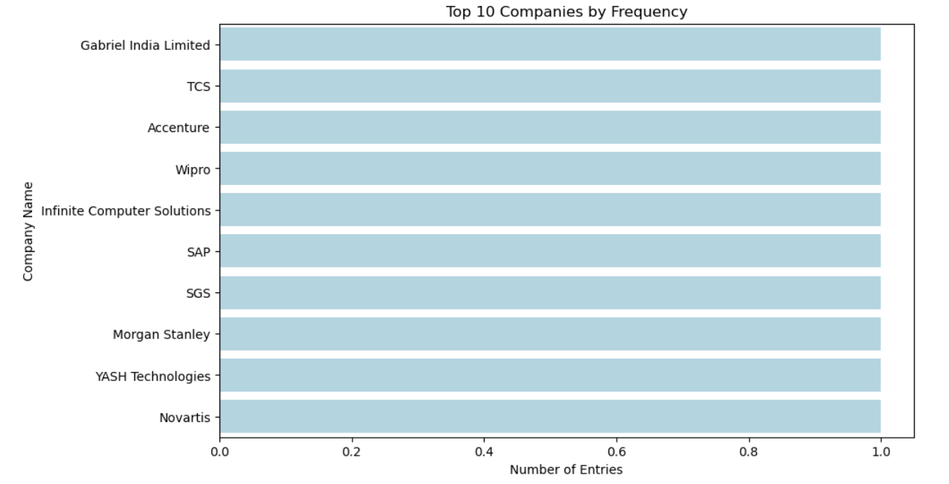
Univariate Analysis:-
Insights from BMI Distribution:
The top 10 companies follows a uniform distribution representing these companies have similar numbers of entries, which allows fair comparison among them.
This shows that while some companies generate a lot of employee data, many smaller or less reviewed companies contribute only a few entries each.

Slide 13
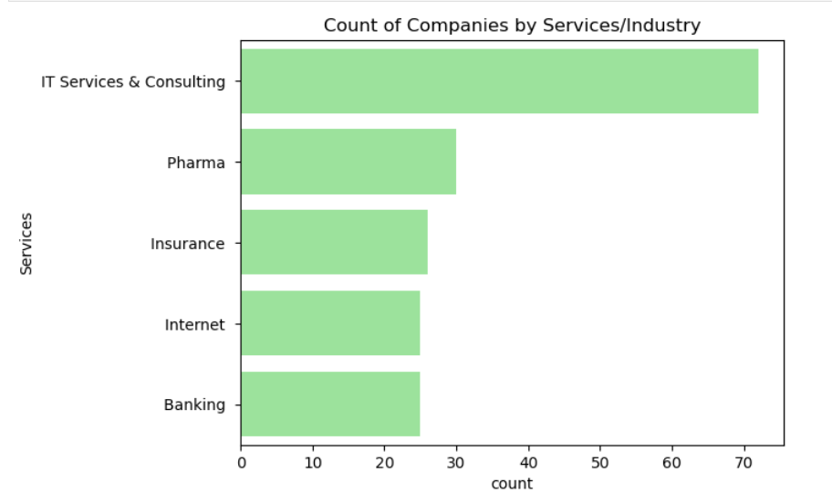
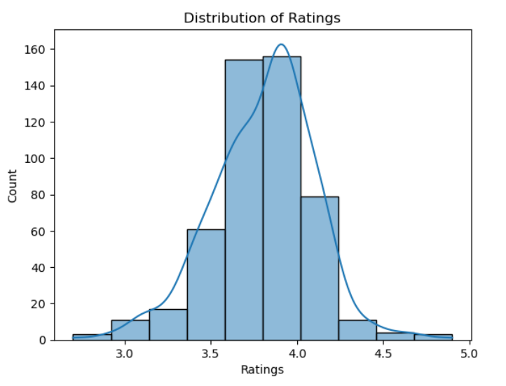
Insights on services:
The top most service is the "IT Services and Consulting" where most of the companies are preferred.
while sectors like Media, Marketing, Medical equipment are having the least count of services.
Insights on ratings:
Most companies have moderate to high ratings(3.7–4.0), indicating that most companies have satisfactory employee ratings.
Ratings follow a near-normal distribution with a slight left skew.
Few companies have the ratings as outliers that is less than 3 and greater than 4.5.

Slide 14
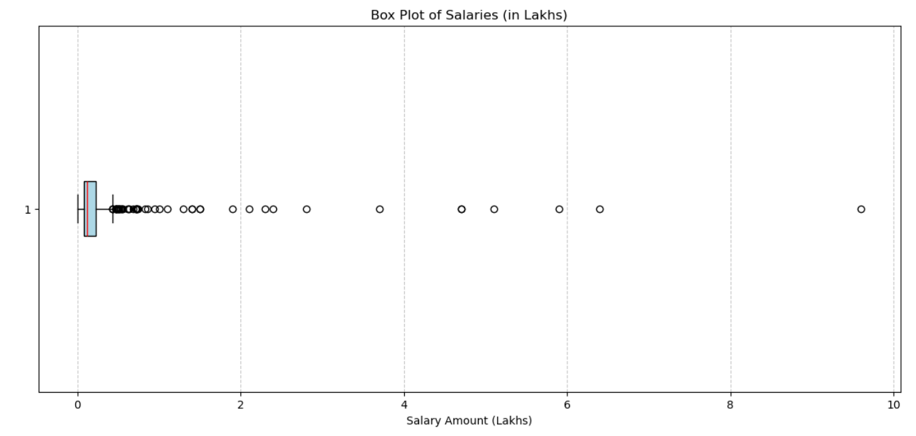
Insights:-
Most companies have salaries concentrated in the lower range (close to 0–1 lakh).
The distribution is right-skewed, meaning a small number of companies pay significantly higher salaries than the majority.
From the graph, there are multiple high-salary outliers, going up to ~9–10 lakh.

Slide 15
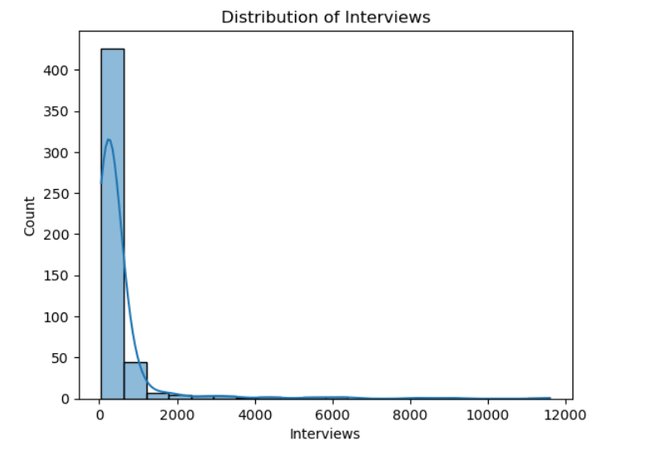
Insights:
Interviews Distribution: The distribution is the right-skewed with more companies are taking the interviews between 1000-1500.
Presence of the outliers are there as there are many few companies which are taking the highest number of interviews.

Slide 16
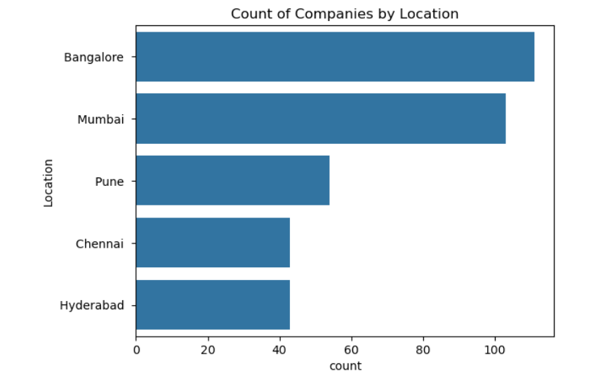
Insights:
The most preferred locations having companies are Bangalore, Mumbai.
Smaller cities are having fewer companies compared to top-most cities.
The least preferred locations are Nagpur, Lucknow, Patna and others.

Slide 17
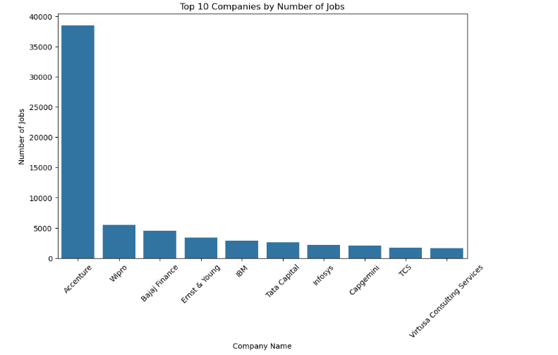
Bivariate Analysis
Insights:
Accenture’s 40,000 jobs are far higher than the next highest values (all below 5,000), making it a clear statistical and visual outlier in the dataset.
Some companies are maintaining the same level of providing job accuracies.

Slide 18
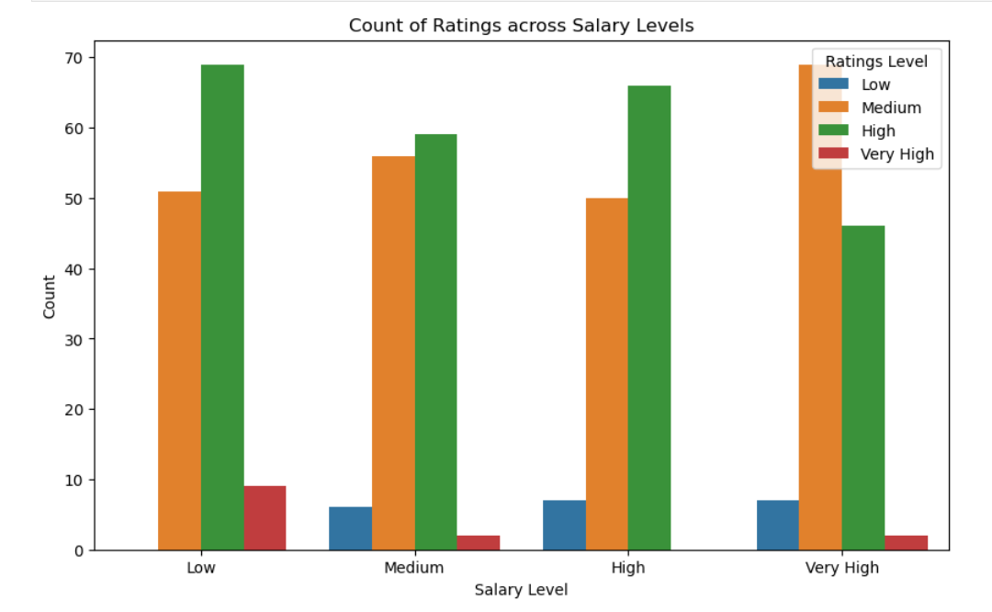
Insights:
The very high rated companies are giving highest salaries to the lowest number of people.
Very high rating are given to only some of the salary levels indicating there is no correlation between the higher salaries and employee's satisfaction.

Slide 19
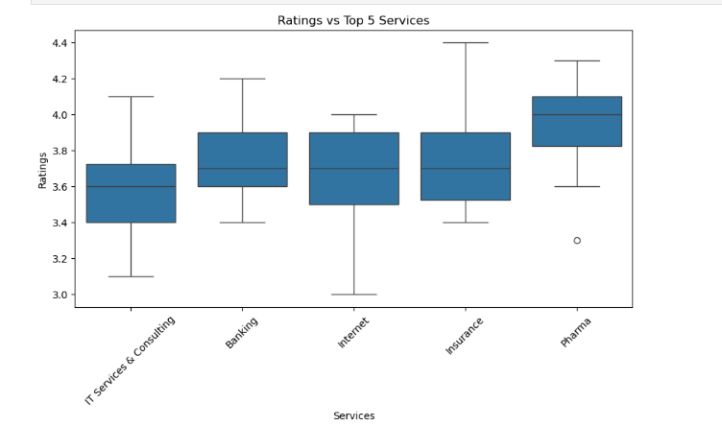
Insights:
Only Pharma has a visible outlier below the box (~3.3) This means most pharma companies have high ratings, but one company is rated significantly lower than the rest.
Pharma companies have the highest median rating, indicating better employee satisfaction (on average), while IT services have a slightly lower median rating.

Slide 20
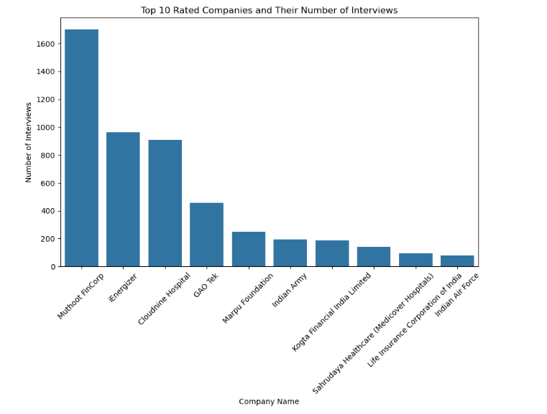
Insights:
Highest interviews doesn't guarantee better ratings.
Most of the top-rated companies only having interviews less than 1000.
Companies with very few interview experiences may still have high ratings.

Slide 21
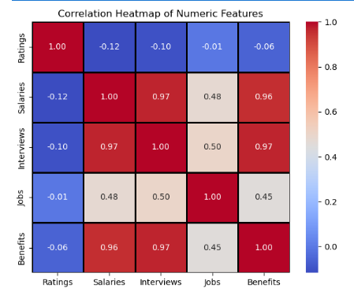
Correlation Heatmap Analysis

Slide 22
Correlation tells us how two variables are related to each other showing direction and the strength of the relationship.
Salaries ↔ Interviews: Moderate positive correlation — companies with higher salaries generally conduct more interviews.
Salaries ↔ Jobs: Weak correlation — salary does not strongly depend on the number of job openings.
Benefits ↔ Salaries: Moderate correlation — companies offering higher benefits also tend to have higher salaries.
Jobs ↔ Interviews: Moderate correlation — more job openings generally lead to more interviews.
Ratings ↔ Other Features: Weak correlations — ratings are only slightly affected by other numeric metrics.

Slide 23
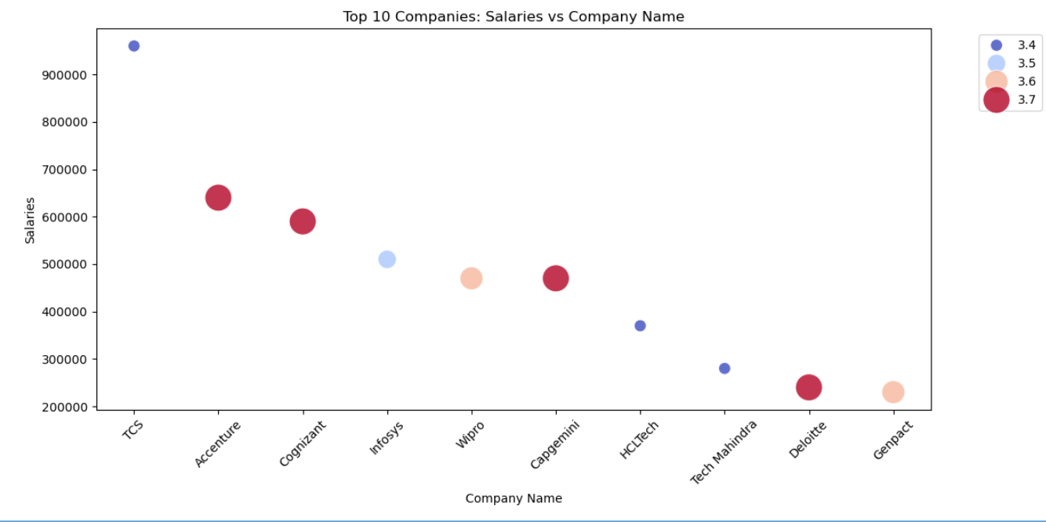

Slide 24
Challenges Faced
• Handling outliers without losing key data patterns.
• Interpreting multiple feature relationships effectively.
• Choosing meaningful visualizations to highlight insights clearly.

Slide 25
Insights
Company Distribution & Location:
Most companies are concentrated in Bangalore, Hyderabad, and Mumbai.
IT Services & Consulting is the dominant industry, followed by Banking, BPO, Telecom, and Retail.
Salaries:
Salary distribution is positively skewed: most companies offer low-to-mid range salaries, and only a few offer very high salaries.
IT and Banking sectors tend to offer slightly higher salaries.
Job Openings & Interviews:
IT companies have the highest number of job openings and interview reviews.
Employee Ratings:
Average ratings are around 3.5–3.8, indicating generally moderate to good satisfaction.
Very few companies have ratings below 3.Benefits:Most companies are giving more benefits.

Slide 26
Summary & Conclusion
The top companies based on jobs are Wipro, Accenture, TCS and others.
Most companies are in IT Services & Consulting, concentrated in Bangalore, Hyderabad, and Mumbai.
Salaries are mostly low-to-mid range, with IT and Banking slightly higher.
Benefits are moderate, often better in IT, MNCs, Banking, and Telecom.

Slide 27


